Slide 1
Bluetooth Low Energy (BLE)

Slide 2
Table of content
Introduction to Bluetooth Low Energy (BLE)
What is BLE?
Why was it developed?
Applications
BLE vs. Bluetooth Classic
Power consumption
Data rate
Range and use cases
Physical Layer of BLE
Frequency band and channels
Modulation scheme
Variants

Slide 3
What is BLE ?
Bluetooth Low Energy (BLE) is a wireless communication technology designed for short-range data exchange with very low power consumption. It was standardized in 2010 as part of the Bluetooth Core Specification version 4.0, introducing a lightweight alternative to Classic Bluetooth. Unlike Classic Bluetooth, which focuses on continuous data transmission, BLE is optimized for efficiently sending small bursts of data while conserving energy. It operates in the 2.4 GHz ISM band, uses a different channel structure for reliability, and provides features such as fast connection setup, extended range, and long battery life for connected devices.

Slide 4
Why BLE ?
Low Power Consumption → devices can operate for long periods on small batteries.
Lower Complexity → simpler protocol compared to Classic Bluetooth, making it easier to implement.
Lower Cost of Radio Transceivers → BLE chips are cheaper to produce and integrate.
Efficient for Small Data → designed to handle short, infrequent data transmissions.
Fast Connection Setup → devices can quickly connect and disconnect, saving energy.
Operates in 2.4 GHz ISM Band → globally available, no licensing required.

Slide 5
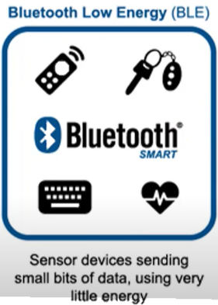
BLE Applications
Bluetooth Low Energy (BLE) is mainly designed for measurement and control applications that require the exchange of small amounts of data without the need for continuous streaming. Unlike Classic Bluetooth, BLE is not suited for audio or video transmission, but instead focuses on efficient, low-power communication. A key advantage is that pairing is not required for most BLE use cases, which simplifies device interaction and reduces complexity. These features make BLE ideal for systems that need to connect quickly, transfer essential data, and then return to a low-power state, allowing devices to run for long periods on small batteries. Because of its flexibility and cost-effectiveness, BLE has become one of the most widely adopted technologies in the Internet of Things (IoT) ecosystem.

Slide 6

BLE Applications
Wearables → smartwatches, fitness bands, and activity trackers.
Healthcare → wireless medical sensors and monitoring devices.
Smart Home → lighting control, smart locks, and environmental sensors.
Industrial IoT → machine monitoring, asset tracking, and predictive maintenance.
Automotive → keyless entry, tire pressure monitoring, and sensor networks.
Beacons & Location Services → indoor navigation, tracking, and proximity services.
Consumer Electronics → wireless peripherals like keyboards, mice, and controllers.
Smart Cities → traffic monitoring, parking systems, and environmental sensing.

Slide 7
BLE and Classic Bluetooth
 | Bluetooth Classic | Bluetooth LE
Frequency band | 2.4 – 2.480 GHz | 2.4 – 2.480 GHz
Channels | 79 channels with 1 MHz spacing | 40 channels with 2 MHz spacing (3 advertising channels/37 data channels)
Modulation | GFSK: bit per symbol π/4-DQPSK :2bit per symbol higher throughput 8DPSK : 3bit per symbol | GFSK : lower throughput
Data Rate | EDR PHY (8DPSK): 3 Mb/s EDR PHY (π/4 DQPSK): 2 Mb/s BR PHY (GFSK): 1 Mb/s | LE 2M PHY: 2 Mb/s LE 1M PHY: 1 Mb/s LE Coded PHY (S=2): 500 Kb/s LE Coded PHY (S=8): 125 Kb/s
Data Transports | Asynchronous Connection-oriented Synchronous Connection-oriented | Asynchronous Connection-oriented Isochronous Connection-oriented Asynchronous Connectionless Synchronous Connectionless Isochronous Connectionless
Communication Topologies | Point-to-Point (including piconet) | Point-to-Point (including piconet) Broadcast Mesh

Slide 8
BLE and Classic Bluetooth
 | Bluetooth Classic | Bluetooth LE
Frequency band | 2.4 – 2.480 GHz | 2.4 – 2.480 GHz
power Consumption | Very low (optimized for long battery life) | Higher (not suitable for coin cells)
Application Focus | Measurement & control (small data) | Continuous streaming (audio, data)
Throughput | Lower (~1–2 Mbps) | Higher (~3 Mbps)
Latency | Low, fast connection setup | Higher latency, slower setup
Voice Capability | Not supported | Fully supported (calls, audio)

Slide 9
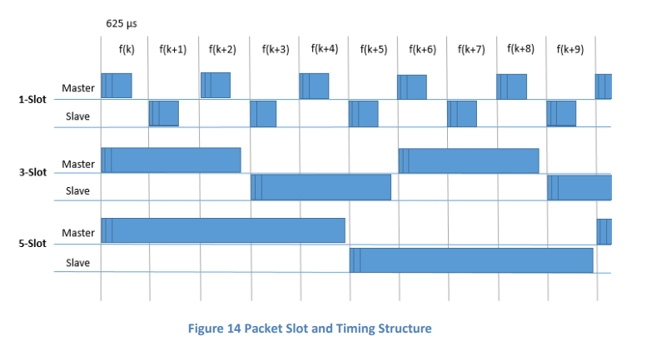
BLE and Classic Bluetooth
In BR/EDR : The physical RF channel is divided into time slots - each slot has length equal 625 µs - where each slot is associated with a particular hop frequency, one packet can take up to 5 slot, each slot is numbered according to 27 bit of the Bluetooth clock

Slide 10
BLE and Classic Bluetooth
In Bluetooth LE:
BLE introduce a different concept on how connection between central and Peripheral are
A device send an advertisement packet, A number of parameters are specified in the request. Amongst these parameters are connection interval, peripheral latency, supervision timeout and channel map. These parameters makes both master and slave be synchronized so they wake up and sleep in same scheduled
Connection interval: defines how often in milliseconds, the radio can be used for servicing this connection ranged from 7.5ms to 4s
Peripheral latency : defines s the number of consecutive connection events during which the Peripheral does not have to be listening. This allows the Peripheral to save power

Slide 11
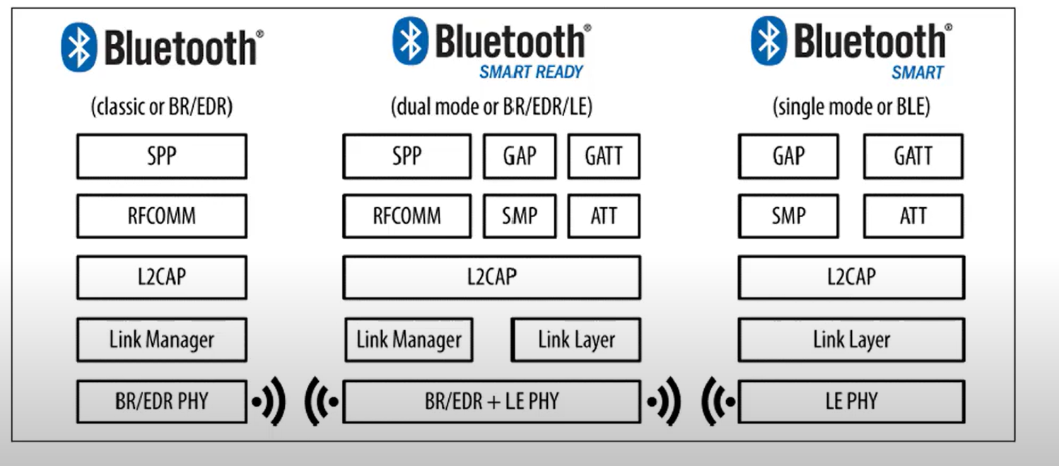
BLE and Classic Bluetooth
Although Bluetooth Low Energy uses the same 2.4 GHz ISM band as Classic Bluetooth, the two are not directly compatible because they use different protocols and channel structures. To enable communication between BLE devices and traditional Bluetooth devices, a special category of devices was introduced called Bluetooth Smart Ready (or dual-mode devices). These devices integrate both the Classic Bluetooth and BLE stacks, acting as a bridge that allows interoperability between the two technologies.

Slide 12
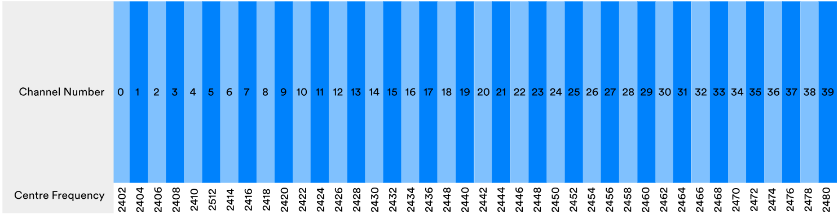
Physical Layer
The physical layer of Bluetooth Low Energy (BLE) defines how the radio transmitter and receiver encode and decode digital data. It operates in the 2.4 GHz ISM band (2400–2483.5 MHz), divided into 40 channels of 2 MHz each, and uses Gaussian Frequency Shift Keying (GFSK) modulation for data transmission.

Slide 13
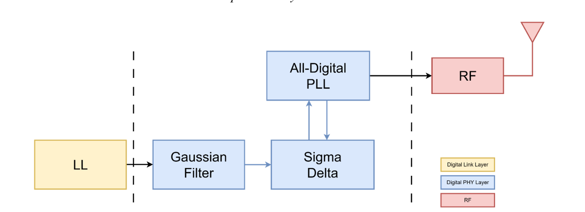
Physical Layer

Slide 14
Physical Layer

